Slide 1
JAVA PROJECT
Team Members
Sanjay__2620030215
Nivedith__2620030131
ATM TRANSACTION SIMULATOR
ATM Transaction Simulator | 1

Slide 2
1. Introduction
• An ATM (Automated Teller Machine) provides self-service banking operations.
• This project simulates common ATM transactions using Java.
• It demonstrates menu-driven programming, validation, balance management, and transaction processing.
• The simulator is intended for academic demonstration and does not connect to a real bank.
ATM Transaction Simulator | 2

Slide 3
2. Problem Statement
• Manual demonstration of ATM logic can be difficult without a working prototype.
• A simulator is needed to model user authentication and common transactions.
• The system should securely validate a PIN before allowing account operations.
• It should handle invalid input and insufficient balance in a controlled way.
ATM Transaction Simulator | 3

Slide 4
3. Objectives
• Develop a console-based ATM transaction simulator in Java.
• Implement PIN authentication and limited login attempts.
• Provide balance inquiry, cash withdrawal, deposit, and PIN change.
• Validate transactions and display clear success/error messages.
• Demonstrate core Java concepts such as classes, methods, loops, conditions, and Scanner input.
ATM Transaction Simulator | 4

Slide 5
4. Existing System
• Traditional ATM software is connected to banking databases and transaction networks.
• It requires real customer accounts, bank authorization, hardware interfaces, and security controls.
• Such infrastructure is unsuitable for a simple classroom demonstration.
• Students often need a lightweight local model to understand ATM transaction logic.
ATM Transaction Simulator | 5

Slide 6
5. Proposed System
• A Java-based local ATM simulator with a menu-driven interface.
• Authentication is performed using a sample account number and PIN.
• Transactions update an in-memory account balance during program execution.
• Input validation prevents invalid withdrawals and other incorrect operations.
• The design can later be extended to file/database storage and a graphical interface.
ATM Transaction Simulator | 6

Slide 7
6. System Architecture
• User → ATM Console → Authentication Module → Transaction Menu
• Transaction Menu → Balance / Withdraw / Deposit / PIN Change Modules
• Transaction Modules → Account Data (account number, PIN, balance)
• All operations return status messages to the console.
• No real banking network or financial account is accessed.
ATM Transaction Simulator | 7

Slide 8
7. Functionalities
• User authentication with account number and PIN.
• Maximum login attempts to prevent endless guessing.
• Balance inquiry.
• Cash withdrawal with amount and balance validation.
• Cash deposit with positive-amount validation.
• PIN change with current-PIN verification.
• Exit option and transaction status messages.
ATM Transaction Simulator | 8

Slide 9
6. System Architecture
USER
ATM CONSOLE
AUTHENTICATION
TRANSACTION MENU
ACCOUNT DATA
• Modules: Login → Menu → Transaction Processing → Account Update
• Data remains in memory for the current program session.
ATM Transaction Simulator | 9

Slide 10
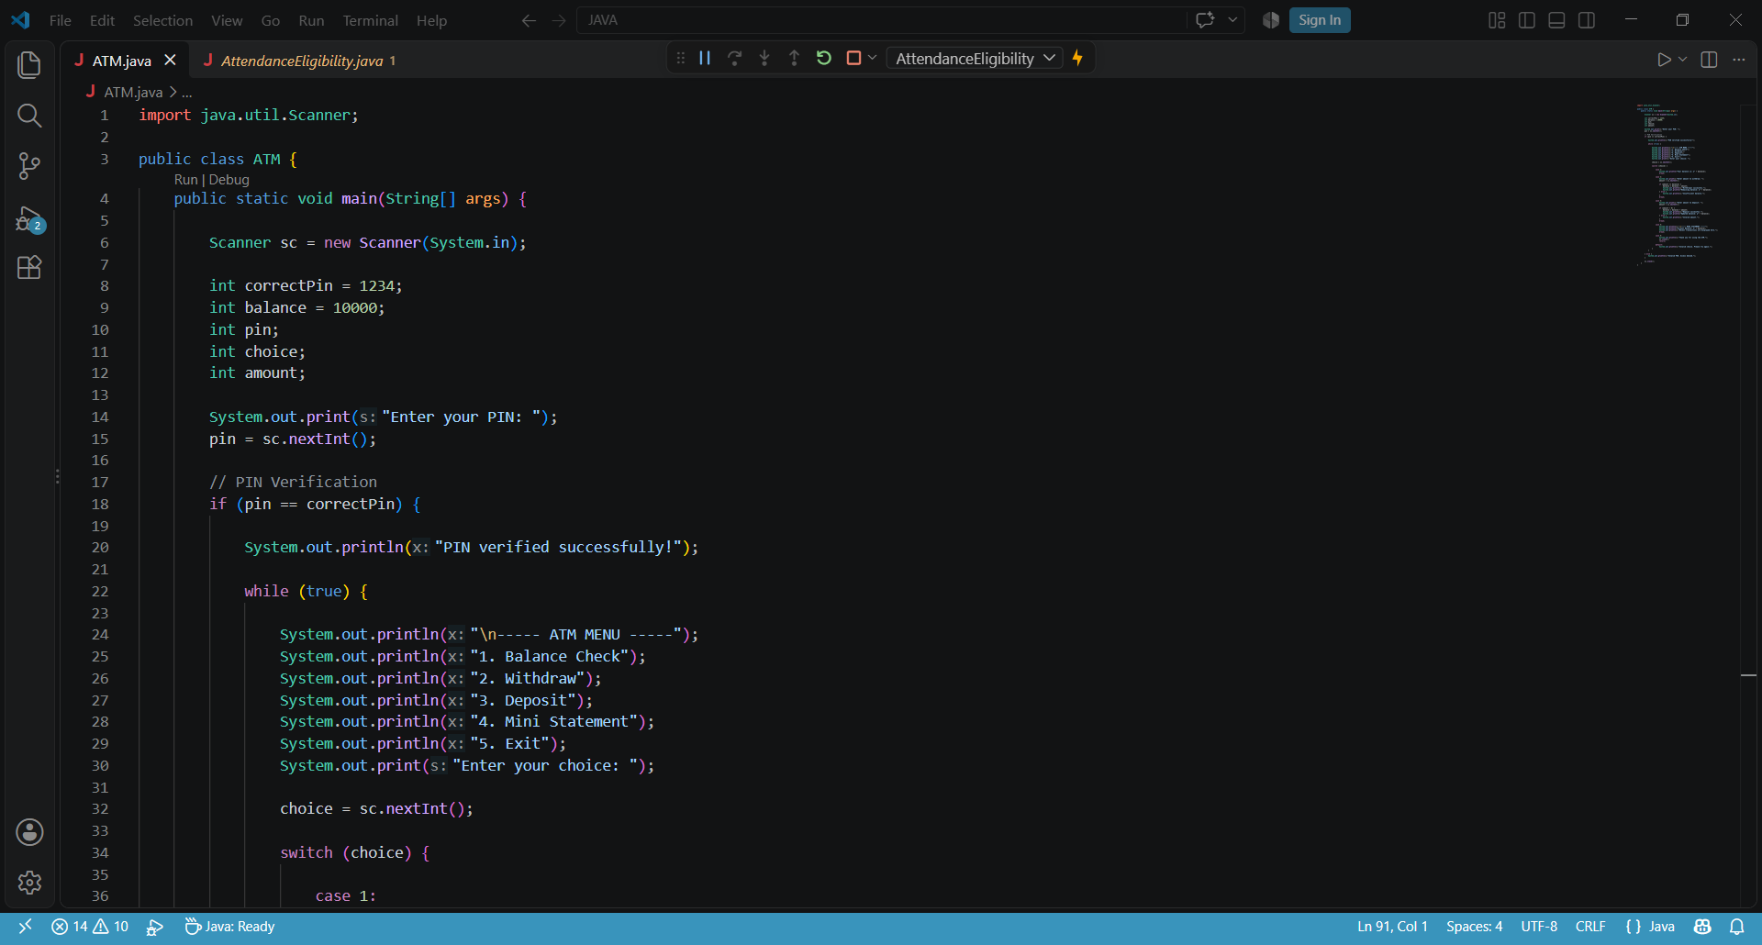
8. Implementation – Java Code Screenshots
);
ATM Transaction Simulator | 10

Slide 11
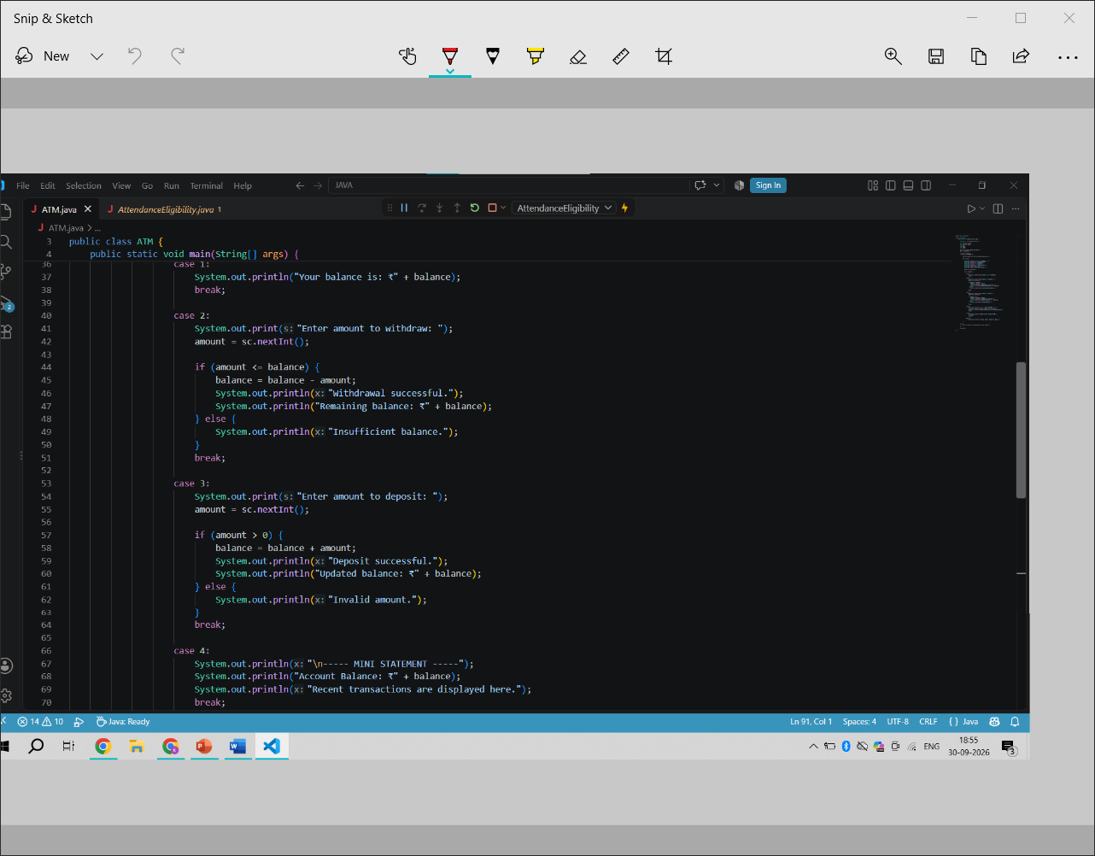
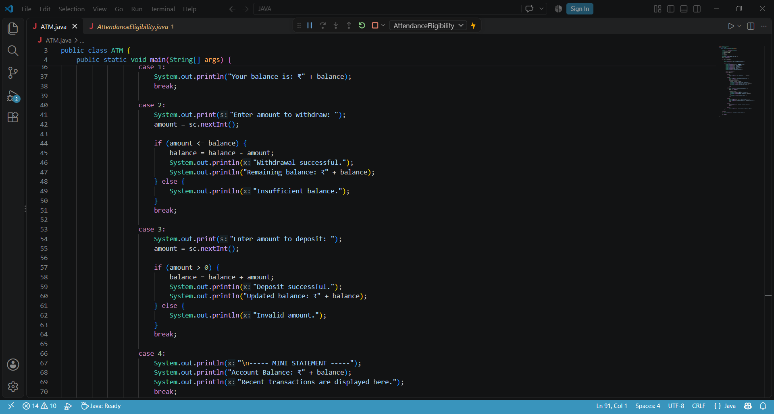

Slide 12
9. Output Screenshots
LOGIN SCREEN
-------ATM MENU--------
TRANSACTION
Enter PIN: 1234
PIN Verified Successfully!
1. Balance Check
2. Withdraw
3. Deposit
4. Mini Statement
5.Exit
Enter amount: 2000
Withdrawal successful.
Remaining Balance: ₹8000.00
ATM Transaction Simulator | 12

Slide 13
10. Future Scope
• Develop a Java Swing or JavaFX graphical user interface.
• Store customer and transaction data in MySQL or another database.
• Add transaction history and printable receipts.
• Implement role-based access and stronger authentication mechanisms.
• Add fund transfer, bill payment, mini statement, and account management modules.
• Connect to a controlled banking API only in a secure, authorized environment.
ATM Transaction Simulator | 13

Slide 14
11. Conclusion
• The ATM Transaction Simulator demonstrates the basic workflow of an ATM using Java.
• It covers authentication, balance inquiry, deposit, withdrawal, validation, and exit.
• The project provides a practical example of object-oriented and menu-driven programming concepts.
• It forms a foundation for future database, GUI, security, and transaction-history enhancements.
ATM Transaction Simulator | 14

Slide 15
THANK YOU
ATM Transaction Simulator
ATM Transaction Simulator | 15

